Slide 1




Alcohol Minimum Unit Price
Market impact
Externalities & Tax Vs MUP
Effects on market participants
Intended and unintended consequences

Slide 2

Presenters
Introduction
The overconsumption of alcohol can at times lead to undesired consequences and negative social effects.
One mechanism governments have at their disposal to assist in reducing the impact of this is by implementing a minimum unit price (MUP) at the retailer. The core intention of such a scheme is to curb problem drinkers who inflict harm to themselves and others. This has been introduced in Scotland with mixed results.
Our syndicate sought to undertake a market impact analysis with the aim to understand if such a mechanism is indeed effective, or should governments look to other forms of market manipulation to discourage overuse.

Slide 3
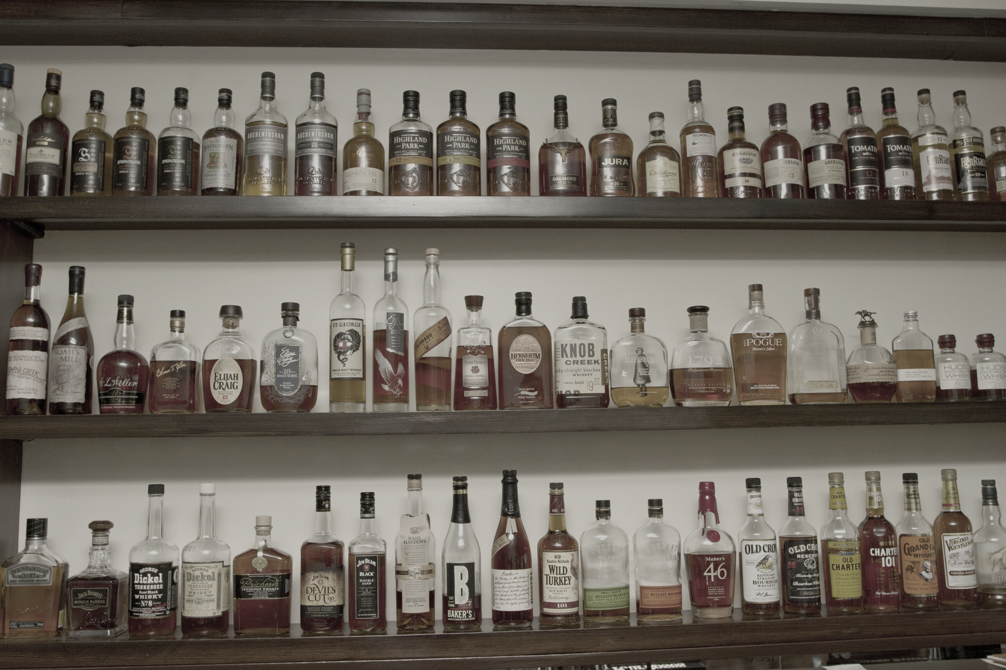
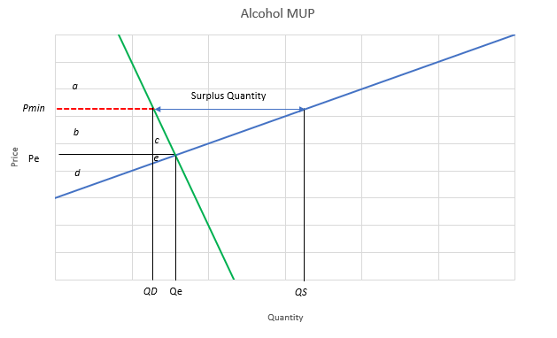
Market Impact – Inelastic Demand
Sector demand is inelastic
Small reduction in quantity proportional to price increase
Emergence of deadweight loss
Rise in producer surplus
Inefficient market creates a surplus quantity and deadweight loss

Slide 4

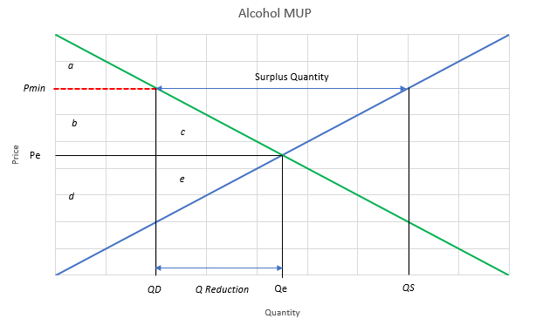
Market Impact – Elastic Demand
Consumer surplus shrinks in favour of producer surplus
Greater effectiveness at overall quantity reduction
Deadweight loss increases
Surplus quantity extends further

Slide 5

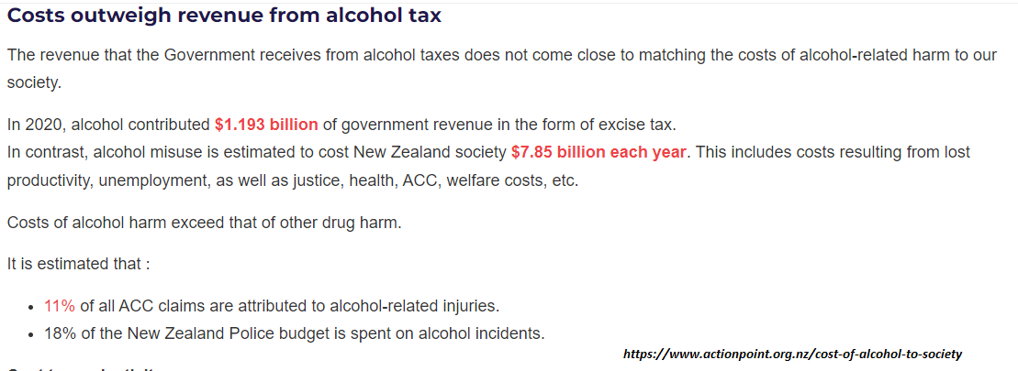
Externalities
An externality, is cost incurred or benefits received by a third-party,
where third party does not have control on the costs and benefits.

Slide 6
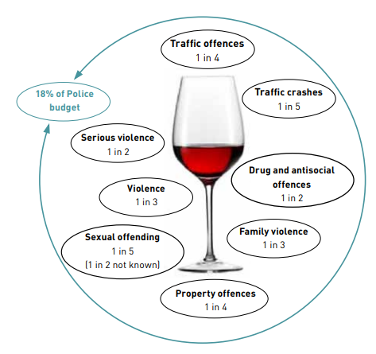
Externalities
Excessive drinking leads to anti-social behaviour which impacts not just those who over-consume but also impose external costs on the health services & uses up the scarce resources of the police and criminal justice system.
Alcohol abuse can also lead to increased absenteeism from work and lower labour productivity in the long run.

Slide 7
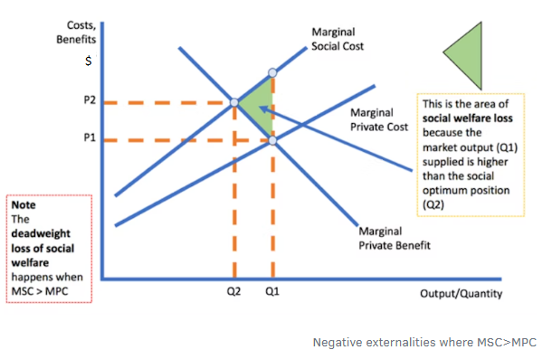
Externalities
Following diagram illustrates the social welfare cost incurred due to alcohol consumption along with the socially optimum point to counter the impact of externalities

Slide 8

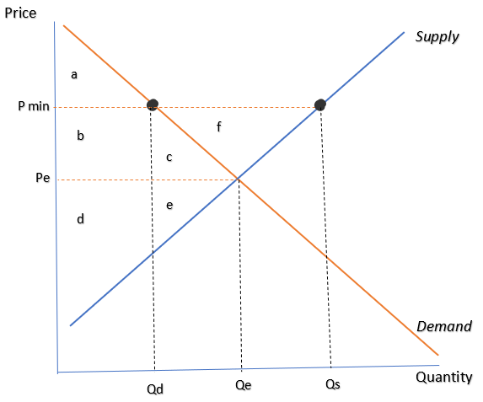
Effect of minimum unit pricing
Consumers will lose after MUP
Producers will gain after MUP
No tax is attracted for restorative programmes (rehab, etc)
 | Consumer surplus | Producer surplus
Before MUP | a + b + c | d + e
After MUP | a | b + d
Deadweight loss | c + e

Slide 9
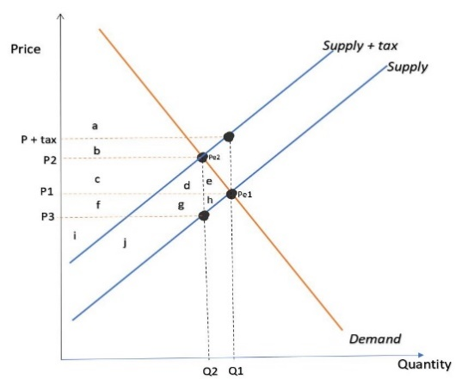
Effect of Taxation
Supply & Demand elasticity impact the proportion of incurred tax across participant groups
Producers advantage is less
Government revenue stream is generated through tax
 | Consumer surplus | Producer surplus
Before Tax | a + b + c + d + e | f + g + h + i + j
After Tax | a + b | i + j
Tax Revenue | c + d + f + g
Deadweight loss | e + h

Slide 10
MUP vs Taxation
Key Differences
MUP | TAX
MUP will impact prices of cheaper products | Tax would apply across the board; all alcohol products would rise in price
MUP could result in revenue gains for some alcohol producers | Tax revenue acquired from alcohol sales could be spent to counter the social cost and negative externalities, if applied at Pigouvian level.
With increase in revenue, producers have opportunity to invest in marketing and grow more sales which eventually result negatively to society | weight gained tax revenue, mass awareness campaigns, rehab programs etc. can be organized to discourage alcohol abuse.

Slide 11

Effect on producers
A significant revenue gain from the market.
Adapt to higher price product channels or scale back production, Which could rise unemployment.
Competing against products in price brackets that are not affected by MUP.

Slide 12

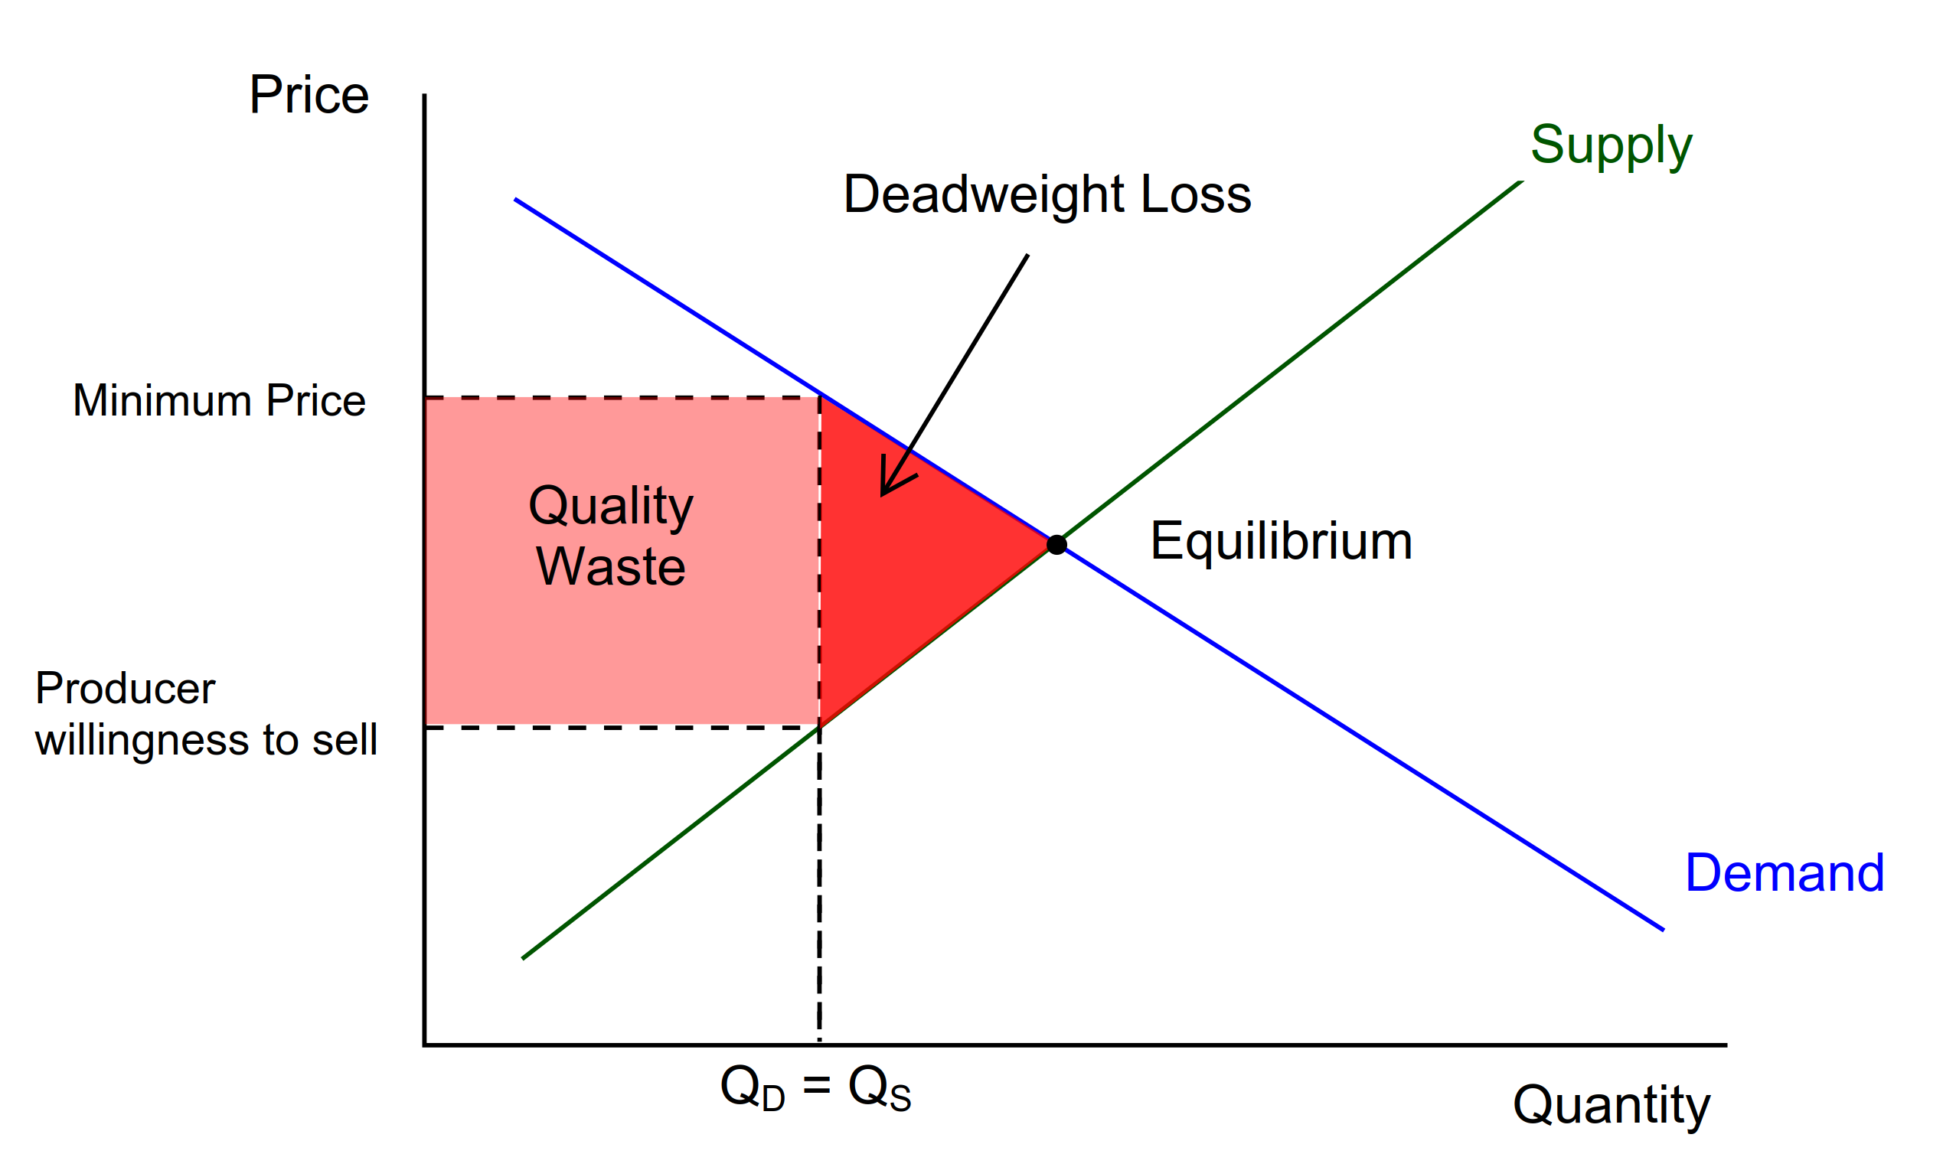
Effect on producers
Competing on basis of quality.
Quality Waste under MUP policy.

Slide 13

Effect on consumers
MUP policy’s impact will be disproportionately felt by low-income homes. Therefore, it will have little impact on moderate consumers or consumers who are not sensitive to cost.
Key takeaways:
Heavy drinkers will be hit hard by the price rise associated with MUP. However, they might cut corners and make room in their budget for their indulgence.
By reducing alcohol sales, the high social costs of alcohol abuse can also be lowered.

Slide 14

Intended Consequences
The policy targets cheap quality alcohol which is the go-to choose of binge drinkers or other problematic consumers. Raising the price of these products removes their competitive advantage and consumers no longer have a strong incentive to buy these products.
With reduced alcohol consumption, over a period of a few years MUP will reduce the number of alcohol related hospitalisations and deaths.
Removing the low-cost drinks will discourage young drinkers from indulging and will further discourage them from forming the habit of relying on alcohol.
MUP is not a tax, for the alcohol producers who are able to sustain their business through the disruption brought by this policy the take-home revenue and profits increase.

Slide 15

Unintended Consequences
The market is tipped in favour of expensive brands as the low-cost brands are stripped of their competitive pricing.
Some consumers may resort to substitutes such as home brews or other narcotics.
Black markets of smuggled or stolen alcohol may emerge. And as the money from MUP goes to manufacturers, the cost of increased policing will fall on the taxpayers.
Problematic drinkers may cut back on other household expenses to fund their indulgence. This would be especially true of alcohol sales that happen at supermarkets, as that will prompt an immediate decision.
This policy will hit low-income households the most as they are more tightly budgeted.
Problem drinkers who favour expensive brands will be unaffected by this policy.

Slide 16

Conclusion
MUP is an effective mechanism to reduce sales of low value alcohol products, that is its limitation.
A relatively blunt instrument that does not allow government the ability to capture funding for restorative programs
Disproportionately targets low-cost consumers and fails to capture problem drinkers in higher cost segments
Low-income consumers are likely to undertake in self destructive behaviors and potentially prioritize alcohol over staple goods

